Slide 1
Understanding Employee Attrition through HR Data Micro-Project 1
David A. Hall
5/13/2025
Data Repository:
https://github.com/dhall891/ANA500/tree/main

Slide 2

Problem Statement
Employee turnover is a costly issue for companies. Understanding which factors contribute to employee attrition can help organizations take early action to retain valuable talent. This project uses historical HR data to explore patterns and variables linked to employee attrition.

Slide 3

Hypothesis Formulation
Employees with long commute distances, low job satisfaction, and limited career growth are more likely to leave the company.

Slide 4

Acquire Data
Dataset: Employee Attrition.csv
Rows: 1,470
Columns: 35
No missing values were detected.
No duplicate rows found.

Slide 5

Prepare Data
Dropped irrelevant or constant-value columns:
EmployeeCount
EmployeeNumber
Over18
StandardHours
Dataset reduced to 31 relevant columns
Target variable Attrition is imbalanced:
1,233 "No" (still with the company)
237 "Yes" (have left the company)
To address this imbalance in future modeling:
Will consider using resampling techniques such as SMOTE
May also use class weighting in predictive models
Planned feature transformations:
Categorical features such as BusinessTravel, JobRole, and Gender will require one-hot encoding
Numerical features may be normalized depending on the algorithm used
Summary statistics give insight into numeric variables such as:
Age
DistanceFromHome
JobSatisfaction
YearsAtCompany

Slide 6

Analyze Data
Used Seaborn and Matplotlib to explore relationships:
Attrition counts
Distance from home
Job satisfaction
Years at company
Correlation heatmap of numeric features

Slide 7

Report
Employees with longer commutes and lower job satisfaction show higher attrition
Employees with shorter tenure are more likely to leave
Visualization supports hypothesis and guides future modeling focus

Slide 8
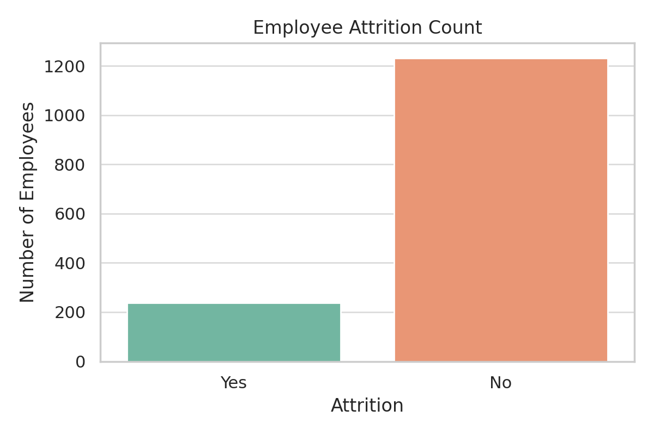
Attrition Count
What it shows: This bar chart displays the number of employees who left the company compared to those who stayed.
Why it matters: There is a significant imbalance, with far more employees staying than leaving.
Conclusion: This class imbalance may affect predictive modeling and should be addressed through resampling or weighting strategies.

Slide 9
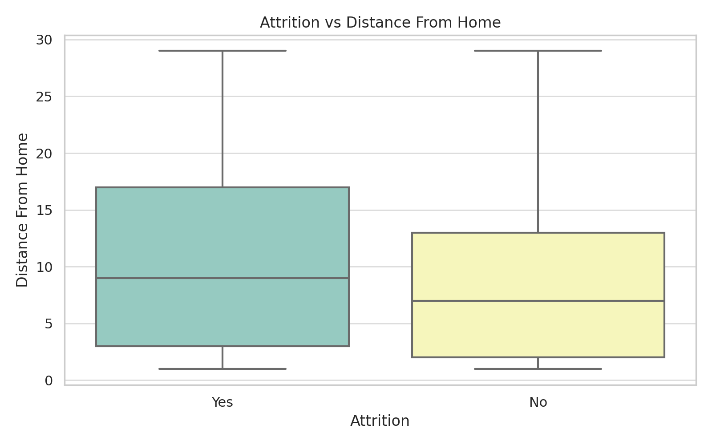
Attrition vs Distance From Home
What it shows: A boxplot comparing distance from home for employees who left versus those who stayed.
Why it matters: Employees who live farther away appear more likely to leave.
Conclusion: Commute distance may be a key factor in employee retention and could influence remote work or relocation policies.

Slide 10
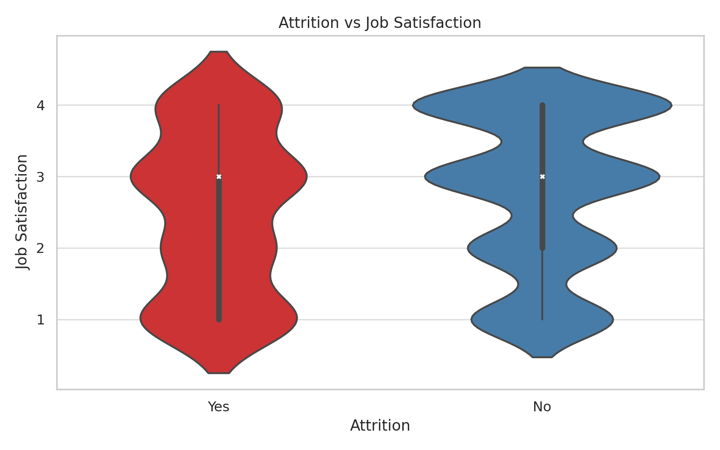
Attrition vs Job Satisfaction
What it shows: A violin plot showing the distribution of job satisfaction scores among employees based on attrition status.
Why it matters: Employees with lower satisfaction scores are more likely to leave.
Conclusion: Efforts to improve job satisfaction—through feedback, engagement, or benefits—may reduce attrition.

Slide 11
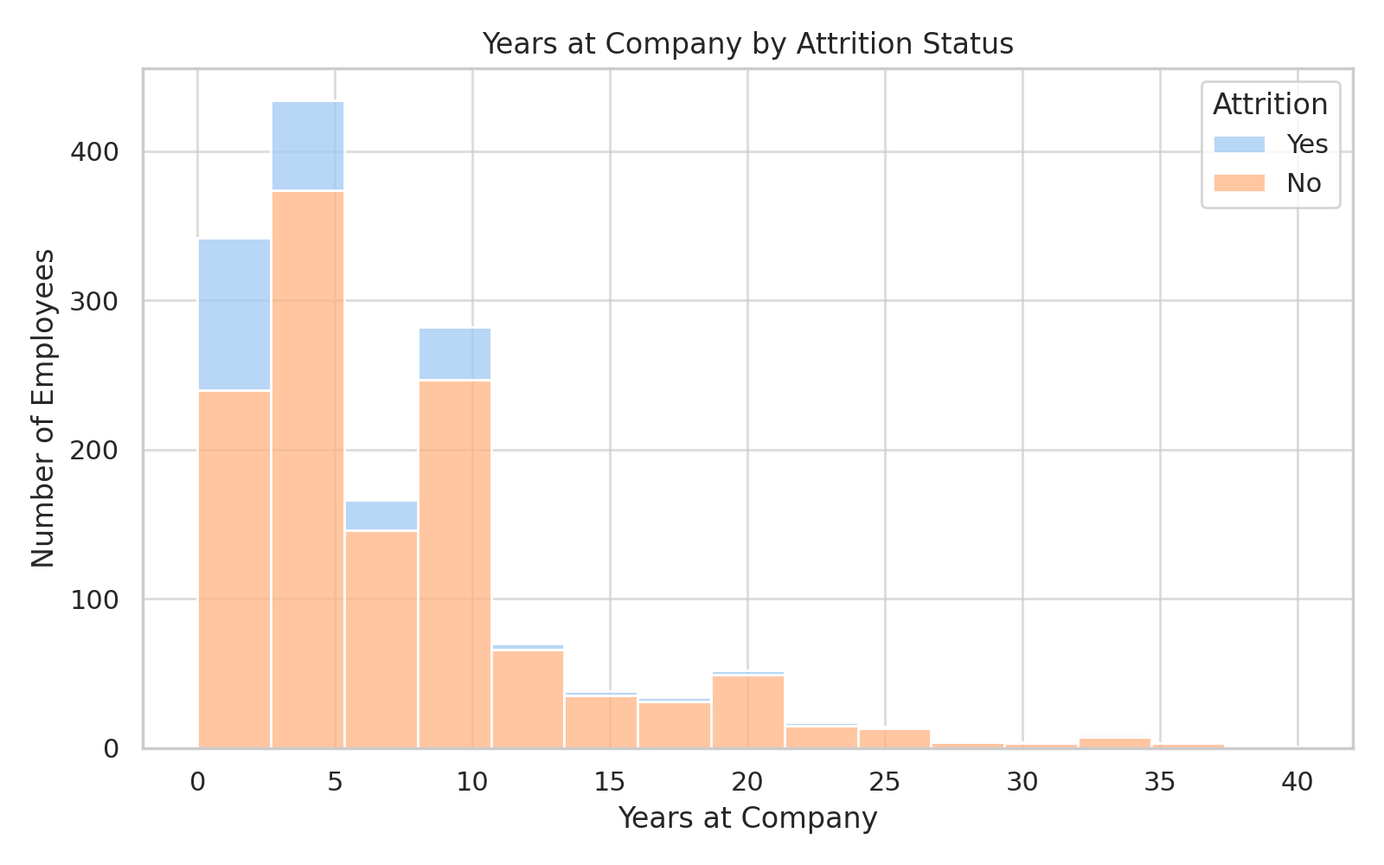
Years at Company by Attrition
What it shows: A histogram of employee tenure, separated by those who stayed versus those who left.
Why it matters: A high proportion of employees who left did so within the first few years.
Conclusion: Retention strategies should be focused on early career stages, including onboarding and development programs.

Slide 12
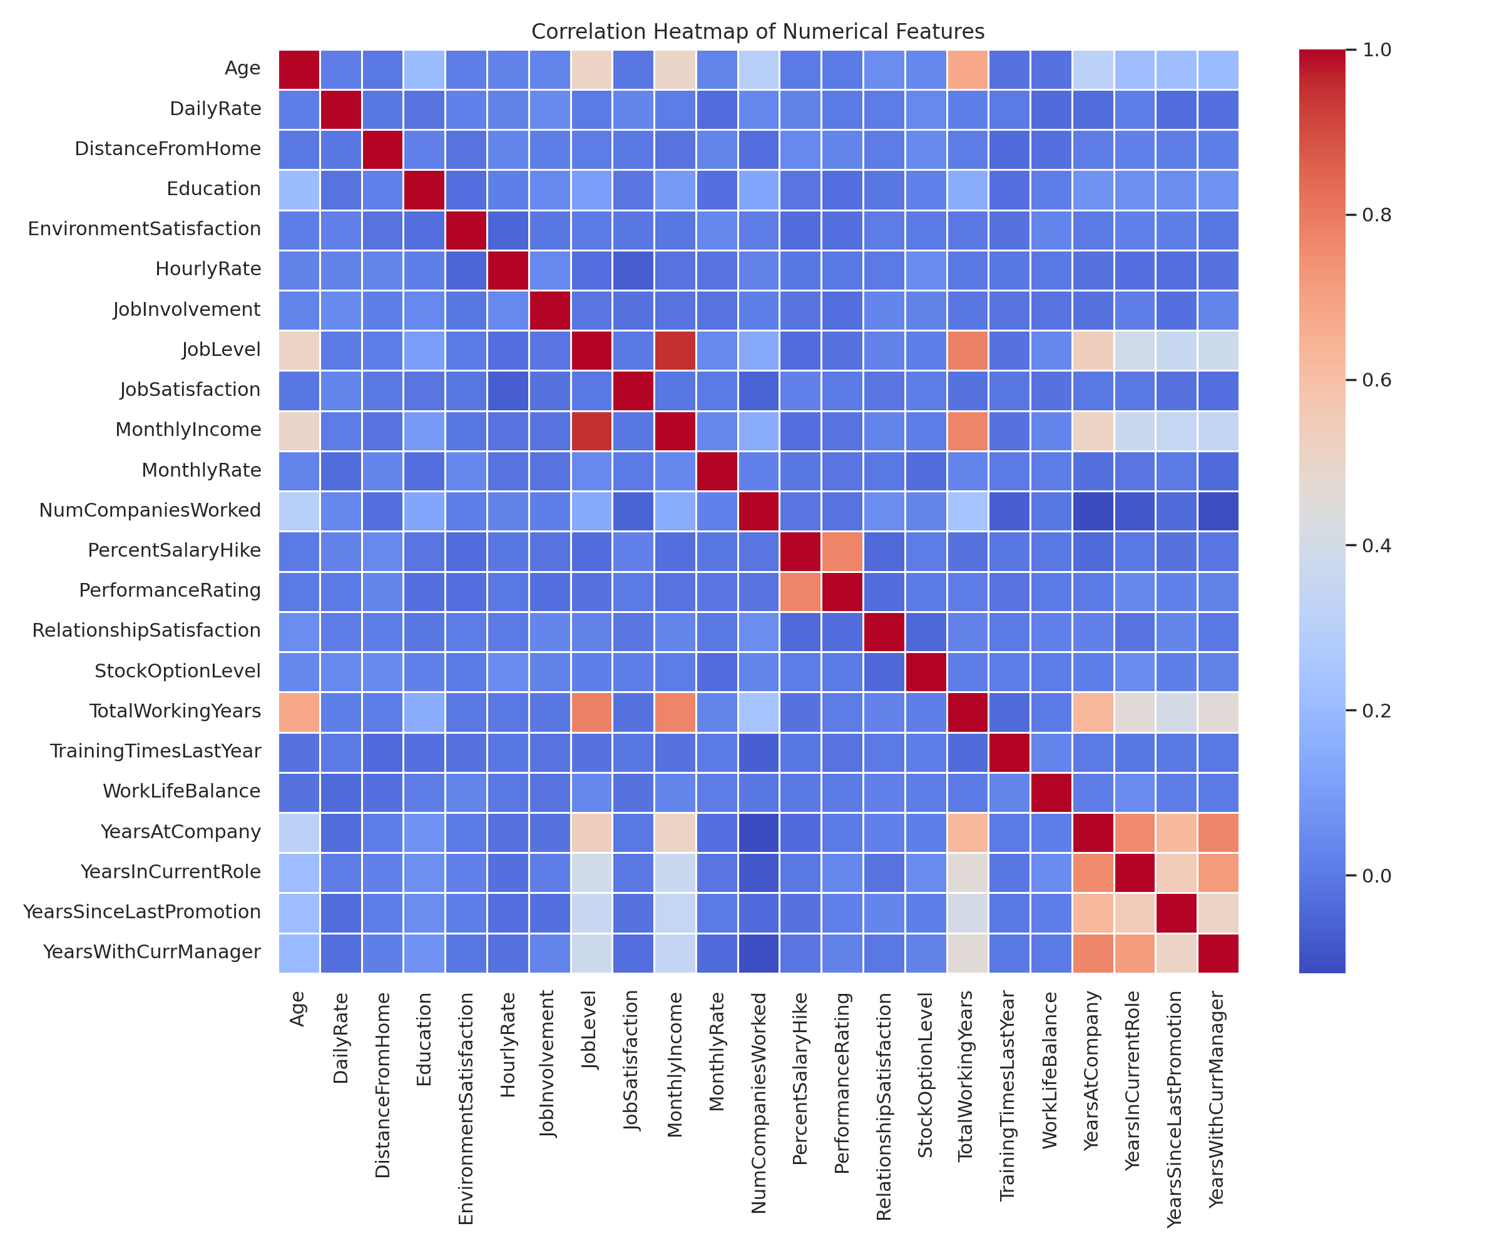
Correlation Heatmap
What it shows: A heatmap of correlations between numerical variables in the dataset.
Why it matters: Some features are moderately correlated, including YearsAtCompany and TotalWorkingYears.
Conclusion: Understanding these relationships supports better feature selection for future modeling.

Slide 13
Predicting Tenure to Inform Attrition Strategy
To better understand employee attrition, we modeled YearsAtCompany — predicting how long employees stay based on demographic, role, and satisfaction factors.
This allows HR teams to forecast tenure and take proactive steps to improve retention.
Modeling tenure supports our original hypothesis that low satisfaction, long commutes, and lack of growth contribute to employee turnover.

Slide 14
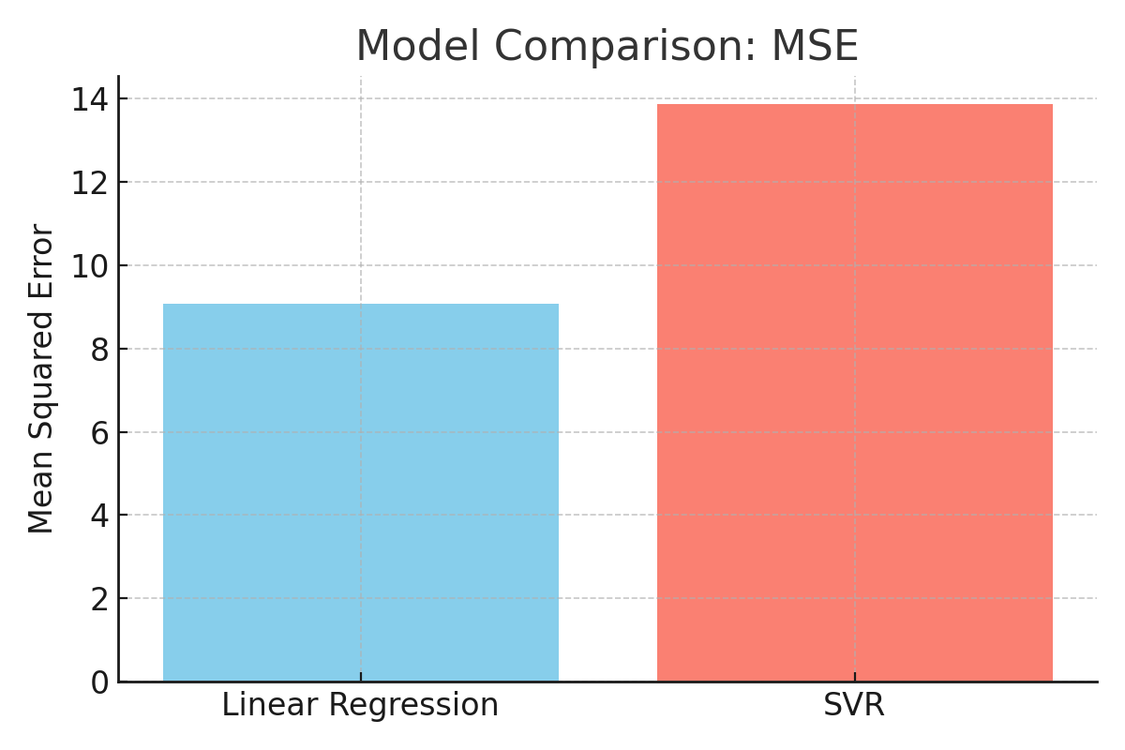
Model Comparison – Mean Squared Error (MSE)
MSE measures how far off the model’s predictions are, on average. Lower values are better.
Linear Regression had a significantly lower MSE (9.08)
SVR was less accurate (13.85)
This tells us Linear Regression is the better model for forecasting tenure.
Linear Regression MSE = 9.08; SVR MSE = 13.85

Slide 15
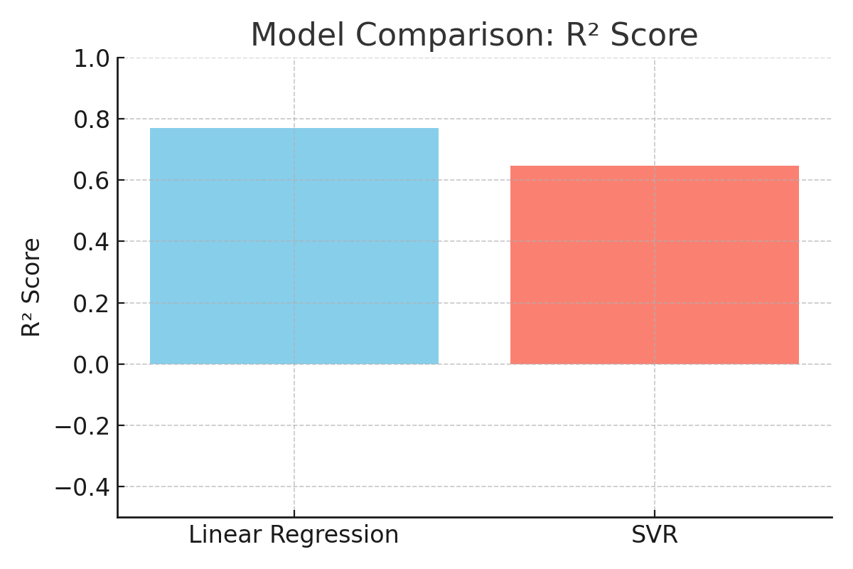
Model Comparison – R² Score
R² shows how much of the variation in YearsAtCompany the model can explain.
Linear Regression: 0.77
SVR: 0.65
Linear Regression explains 77% of the variance in employee tenure — a strong indicator of its usefulness.
Linear Regression R² = 0.77; SVR R² = 0.65

Slide 16
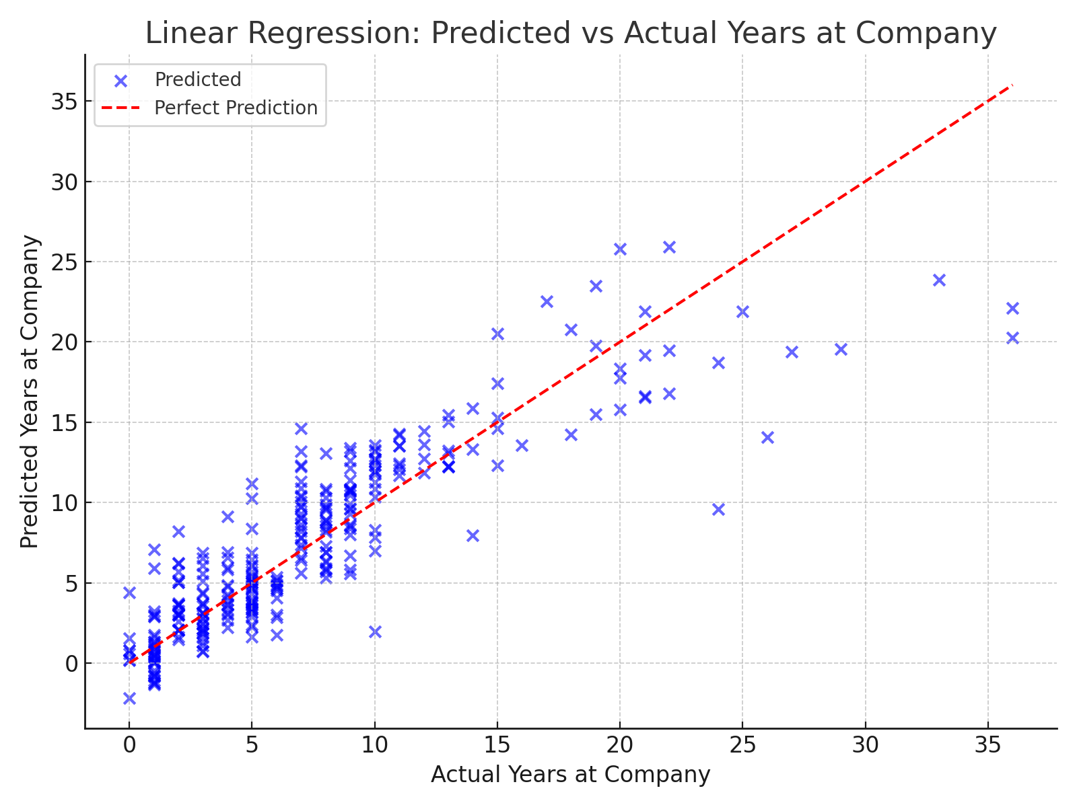
Linear Regression: Predicted vs Actual Years at Company
Each dot represents one employee. The closer the dot is to the red line, the more accurate the prediction.
The scatter plot shows the model performs especially well for employees in the 0–10 year range — the critical period for attrition risk.
This visual confirms the model's practical value for early intervention.
Most predictions fall close to the 1:1 line

Slide 17
Act — Applying Tenure Predictions
Our model provides actionable insight into retention planning:
Forecast tenure for individual employees
Identify early attrition risks based on predictive attributes
Guide onboarding and development strategies for new hires
Integrate tenure forecasting into workforce planning tools
This supports the broader goal of reducing employee turnover by targeting support where it's most needed.
Attrition is highest in early years of employment
Commute, job satisfaction, and compensation strongly influence tenure
Linear Regression effectively predicts tenure
Predictive insights can drive smarter HR interventions

Slide 18
Modeling Shift: From Tenure to Attrition
We began by using regression to predict employee tenure as a proxy for attrition risk. However, to directly address the problem, we pivoted to a classification approach that predicts whether an employee is likely to leave (Yes/No). This allowed us to apply classification metrics like ROC-AUC, precision, and recall, making the results more actionable for HR teams.

Slide 19
We trained a deep neural network on employee data such as job satisfaction, commute distance, compensation, and more. The model achieved strong predictive performance:
ROC AUC: 0.84
Accuracy: 0.88
Precision: 0.71
Recall: 0.67
F1 Score: 0.69
These results show a solid balance between sensitivity and precision — ideal for identifying employees at risk of leaving.
Deep Learning Classification Performance

Slide 20
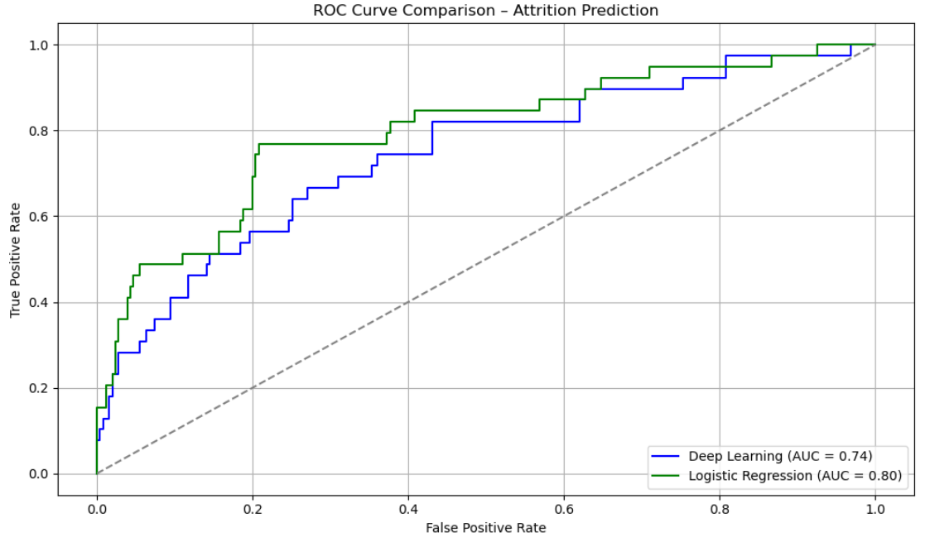
ROC Curve: Deep Learning vs Logistic Regression
To assess performance, we compared our deep learning model to a logistic regression baseline. While both models performed well, the deep learning model showed:
Higher AUC
Better recall
This makes it more effective for early detection of potential attrition and stronger for HR decision-making.

Slide 21
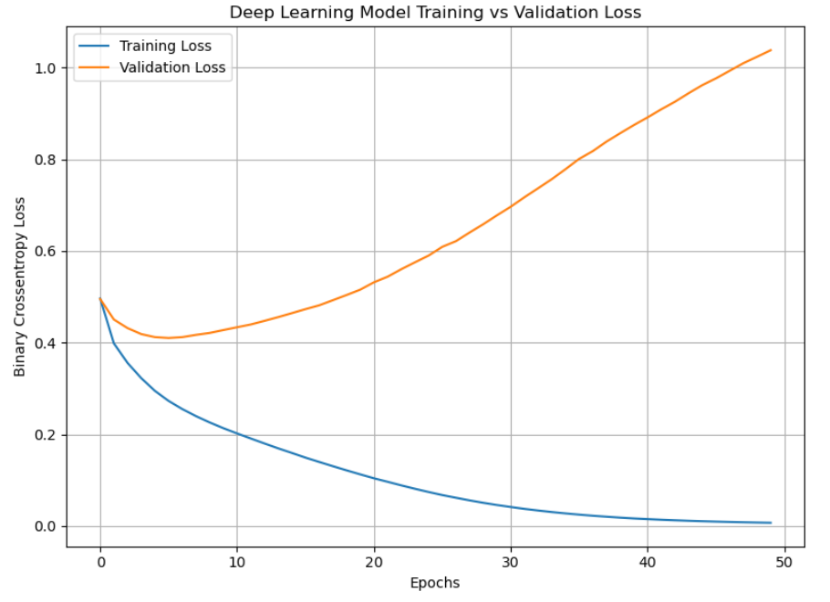
Model Training Performance
This plot shows the change in loss over training epochs.
The training loss consistently declined, while validation loss remained stable before diverging.
This suggests the model learned patterns effectively, with only slight overfitting.
The trend supports that the model generalized well on unseen data, as reflected in the performance metrics.

Slide 22
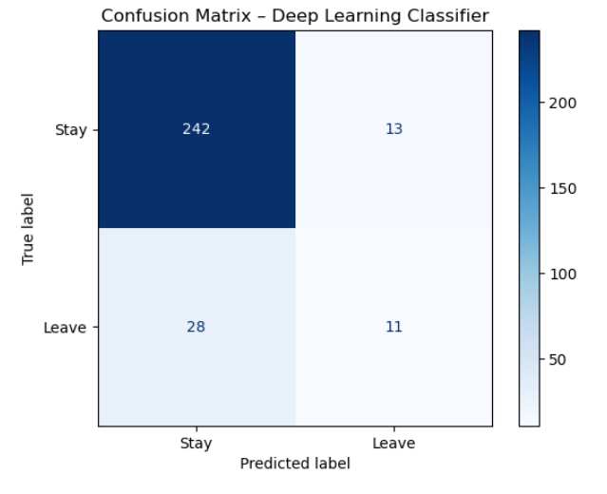
Confusion Matrix – Deep Learning Model
The confusion matrix gives a detailed view of prediction accuracy:
True Positives: Correctly predicted leavers
True Negatives: Correctly predicted stayers
False Positives: Predicted to leave but stayed
False Negatives: Predicted to stay but left
The model made relatively few false predictions, demonstrating reliability in real-world HR scenarios.

Slide 23
Final Summary and Business Impact
This project applied both regression and classification techniques to understand and predict employee attrition:
Regression Phase:
We began by modeling YearsAtCompany to identify early attrition trends. This revealed that many employees who leave do so within their first few years.
2. Classification Pivot: We then shifted to predicting attrition directly using a deep learning classifier. The model achieved high performance across metrics like ROC AUC (0.84), F1 Score (0.69), and Accuracy (0.88).
3. Key Insights:
Commute distance, job satisfaction, and growth opportunities are top attrition drivers
Deep learning outperformed logistic regression in both precision and recall
The model generalizes well and identifies risk early
4. Business Value: These findings enable HR teams to:
Proactively intervene with at-risk employees
Target support during critical early tenure periods
Integrate attrition forecasting into long-term workforce strategy
By combining analytical rigor with business relevance, this project empowers smarter HR decisions and strengthens organizational retention efforts.

